Slide 1

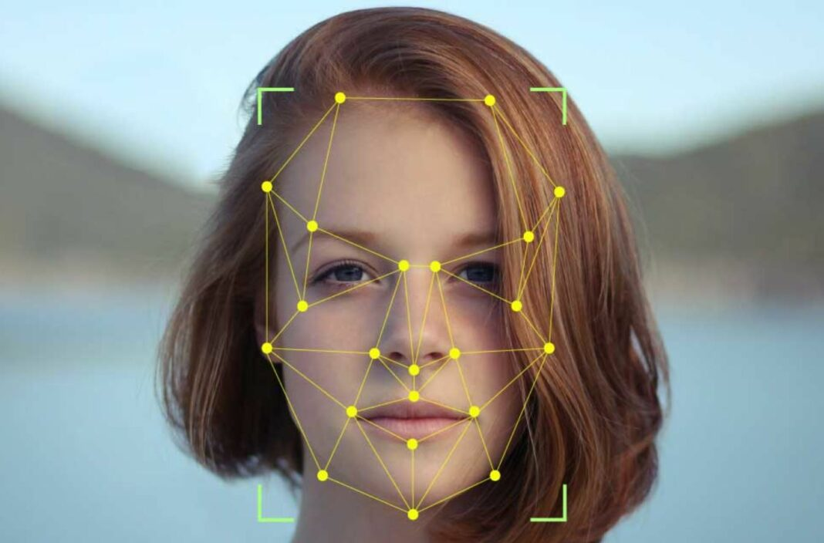
Facial Recognition System
Grp no 63

Slide 2
Background Study
Inspiration : Human beings possess natural ability to recognize hundreds of faces by their visual system and cognition. That makes them recognize familiar faces even after a long period of time. Building an intelligent system similar to human perception system . One way to do achieve it is face recognition system.
. For this purpose, they have focused on detection and recognition of traits and features for individuals such as nose, eyes, mouth, face shape position, size, and beside relationship among traits and features.

Slide 3
Face recognition is a popular type of biometric system. Such systems are essentially pattern recognition systems that
operate by fetching an individual’s biometric data,
extracting a feature set from the acquired data (in this case the face), and comparing this feature against the template set in the database.
Face detection has gained significant importance in recent times. Law Enforcement Agencies, security organizations, personal identification systems and mass surveillance applications all use this technology.

Slide 4
INTRODUCTION
→Nowadays instead of pencil and paper or face to face recognition ,everyday action are increasingly being handled electronically.
→This growth in electronic transactions results in great demand for fast and accurate user identification and authentication.
→Access codes for building , banks accounts and computer system often use PIN’s for identification and security clearances , but the user of the PIN is not verified . When credit and ATM cards are lost or stolen , an unauthorized user can often come up with the correct PIN.
—>Face recognition technology may solve this problem since a face is undeniably connected to its owner expect in case of twins

Slide 5
What is Facial Recognition?
→ Facial recognition is a way to identify or confirm an individual’s identity using their face.
→ There are two types of facial recognition:
Verification : The system compares the given individual with they say they are and gives a yes or no decision.
Identification : The system compares the given individual to all the other individual in the database and gives a ranked list of matches.

Slide 6
History
→ In 1960s, the first semi automated system for facial recognition to locate the features such as eyes,ears,nose and mouth on the photographs.
→ In 1970s, Goldstein and Harmon used 21 Specific subjective markers such as hair colour and lip thickness to automate the recognition.
→ In 1988, Kirby and Sirovich used standard linear algebra technique to the face recognition.

Slide 7
Why do we need facial recognition?
01
The main objective of facial recognition is to identify individuals, whether individually or collectively.
02
It is accurate and allows for high enrolment and verification rates.
03
It can use existing hardware infrastructure, existing cameras and image capture devices will work with no problems.
It requires no physical interaction on behalf of the user.
04

Slide 8
Methodology
Inputs image and Save image to database.
Detects Faces.
Match detected faces to Database.(Features Extraction)
Recognize Faces
Provides information about them.

Slide 9
Block Diagram
INPUT IMAGES
FACE DETECTION
FEATURES EXTRACTION
VERIFICATION/
IDENTIFICATION
FACES RECOGNIZED

Slide 10

Implementation of Code

Slide 11
Software Requirements
IDE
IDLE Python
Libraries
Numpy
Os
Cv2
Face recognition

Slide 12

Execution of the code

Slide 13
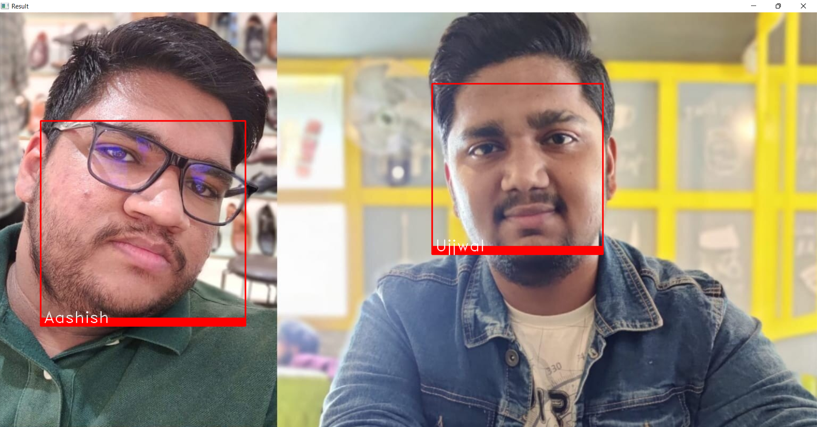

Slide 14
LITERATURE
SURVEY

Slide 15
S no | Year | Paper Title | Method | Accuracy | Merit | De merit
1 | 2020 | Human face recognizing using Neural network | Viola-Jones algorithm and Neural Network | 95% | Better accuracy and detects and recognizes occluded face | Fail to recognize low intensity image and side view image
2 | 2021 | Face mask detection using opencv | TensorFlow and Opencv | 98% | Has better accuracy and recognizes face in mask | Slight delay in getting message.
3 | 2021 | Face mask recognition based ATM security system | Opencv and Haar Cascade Algorithm | 80% | Replace conventional ATM framework and saves fabricating cost of Cards. | Rate of effectiveness can be improved
4 | 2019 | Face recognition for class attendance with opencv | Python IDE,Opencv,Haar Cascade,Viola-Jones algorithm | 90% | Increases security level,Fast and Flexible | Waiting time is large

Slide 16
Occlusion Detection and Recognizing Human Face using Neural Network
Divya Agarwal
21BAI10159
Abstract:
Face recognition is one of the most important problems of verifying or identifying a face from query image or input image. This system has emerged as an important field in case of surveillance systems. Face detection is a very powerful tool for video surveillance, human computer interface, face recognition, and image database management. Occlusion means extraneous objects that hinder face recognition, e.g., face covered with scarf, wearing glasses, beard, cap etc., is one of the greatest challenges in face recognition systems.

Slide 17
Other issues are illumination, pose, expressions etc. An efficient method is used for detection of occlusions, which specifies the missing information in the occluded face. Method used for face detection is Viola-Jones algorithm, for occlusion detection and reconstruction of face fast weighted PCA is used are Neural Network (NN) is used for face recognition. Other appropriate methods are Principal Component Analysis (PCA), Local Binary Pattern (LBP), Eigenfaces. Propose method which is used will detect occluded face and recognize the face with the help of given same faces from the database.

Slide 18
Conclusion
Human often uses faces to recognize individuals. Face detection and alignment are essential to many face applications, such as face recognition and facial expression analysis. Today, recognition technology is applied to a wide variety of problems like passport fraud, human computer interaction and support for law enforcement. As seen from above results, the proposed scheme provides better accuracy than existing system, and accurately detects and recognizes occluded face. Also work on different parameters like structural similarity index and feature similarity index for prove system better. Further I am trying to work on low intensity images and side view image.

Slide 19
Face Mask Detection Using OpenCV
Shubham Singh
21BAI10247
Abstract
The COVID-19 pandemic is causing a worldwide emergency in healthcare. This virus mainly spreads through droplets which emerge from a person infected with coronavirus and poses a risk to others. The risk of transmission is highest in public places

Slide 20
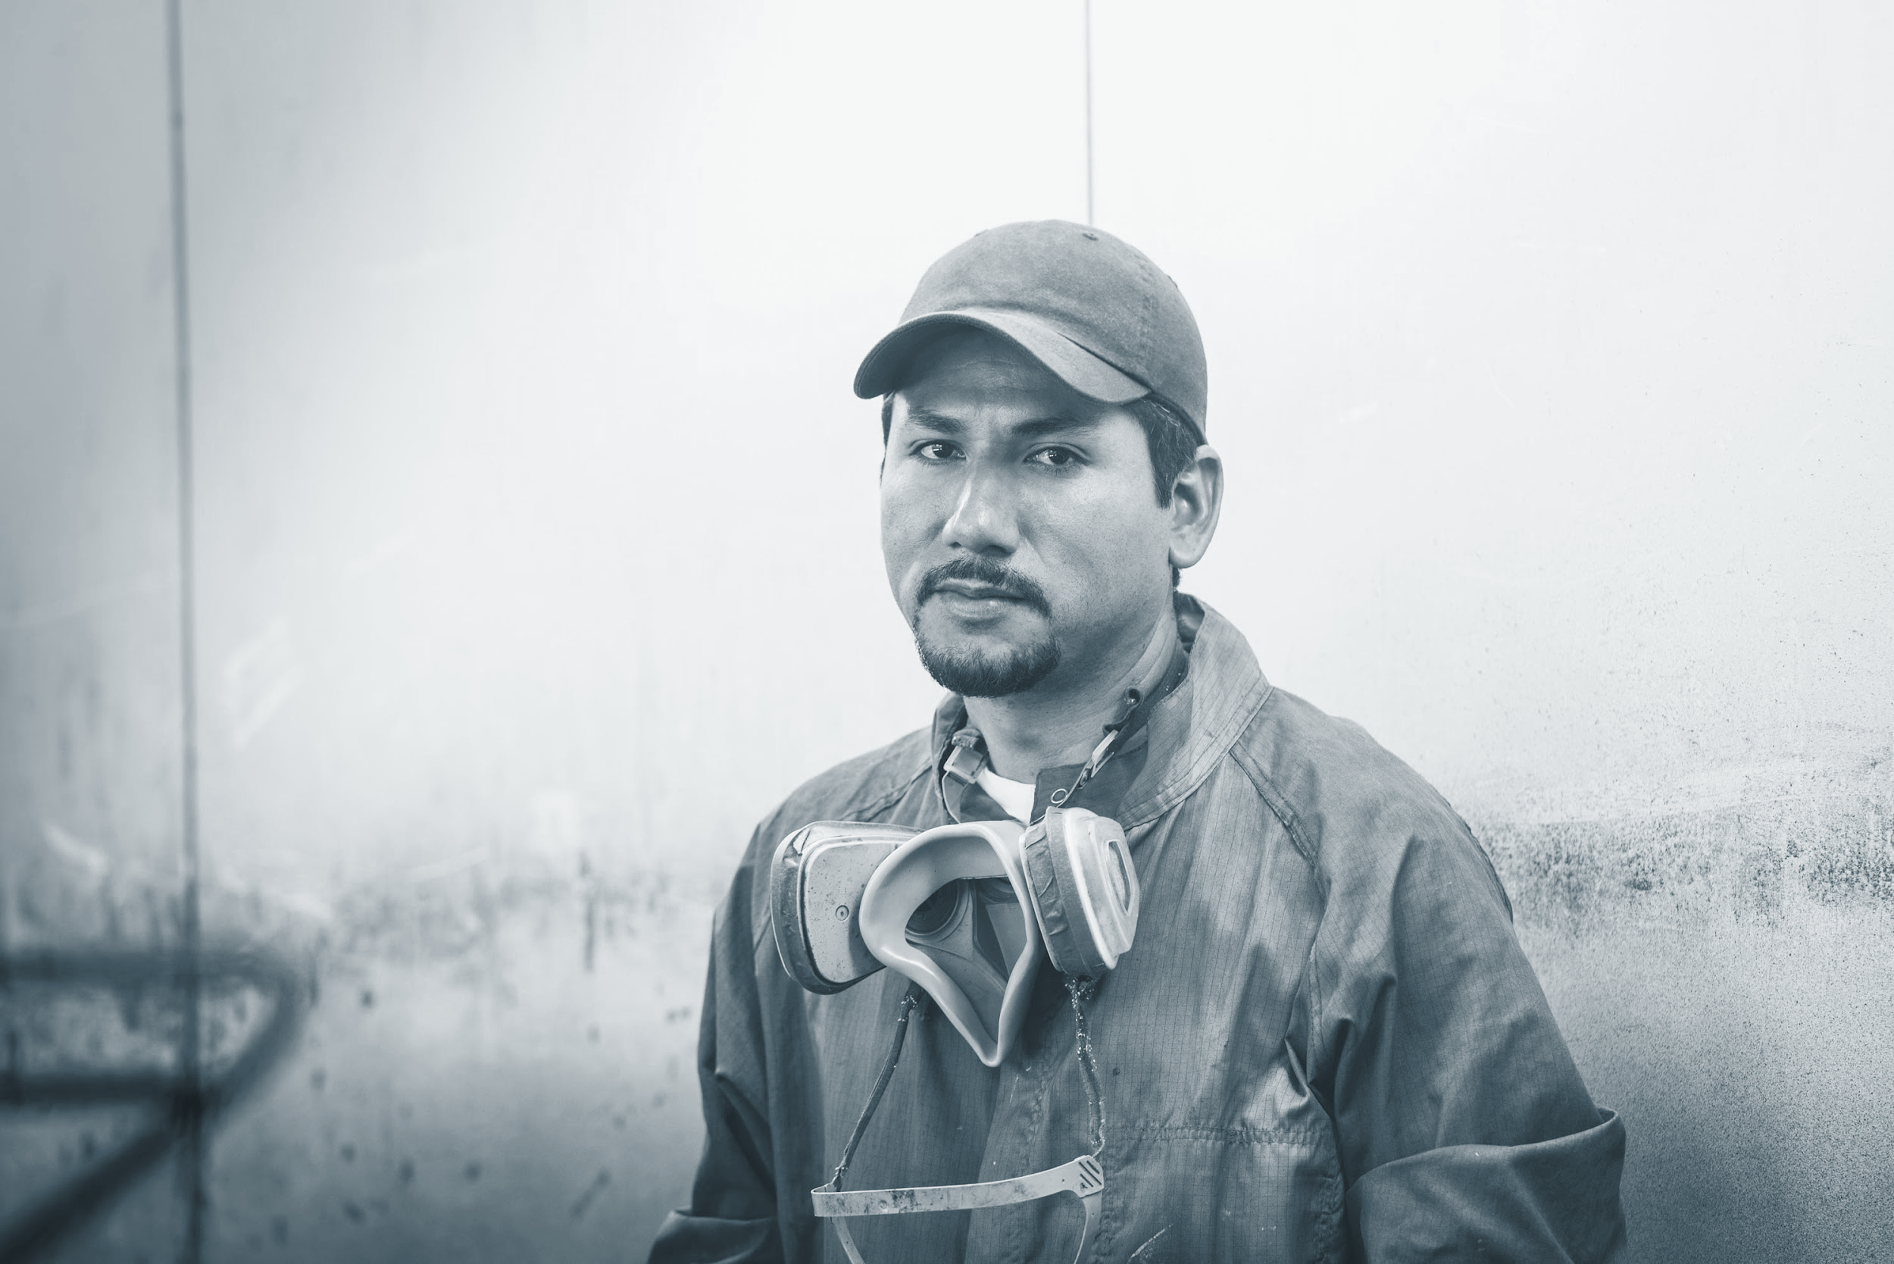


One of the best ways to stay safe from getting infected is wearing a face mask in open territories as indicated by the World Health Organization (WHO). In this project, we propose a method which employs TensorFlow and OpenCV to detect face masks on people.

Slide 21
A bounding box drawn over the face of the person describes weather the person is wearing a mask or not. If a person’s face is stored in the database, it detects the name of the person who is not wearing face mask and an email will be sent to that person warning them that they are not wearing a mask so that they can take precautions.

Slide 22
Conclusion
With the increasing number of COVID cases all over the world, a system to replace humans to check masks on the faces of people is greatly needed. This system satisfies that need. This system can be employed in public places like railway stations and malls. It will be of a great help in companies and huge establishments where there will be a lot of workers. This system will be of a great help there because it is easy to obtain and store the data of the employees working in that Company and will very easy find the people who are not wearing the mask and a mail will sent to that respective person to take Precautions not wearing mask

Slide 23
FACE RECOGNITION BASED ATM SECURITY SYSTEM
UJJWAL SAGAR (21 BAI 10047)
Abstract: In this concept, Automated Teller Machines are broadly utilized step by step by individuals. Be that as it may, it’s difficult to hold their ATM card all over the place, individuals might neglect to have their ATM card or fail to remember their PIN. The ATM card might get harmed and clients can have a circumstance where they can't gain admittance to their cash. In our proposition, the utilization of biometrics for validation rather than PIN and ATM card is enlivened. Here, The Face ID is linked to high need, in light of the fact that the combination of those biometrics ends up being the sole among the distinguishing proof and check procedures. The execution of ATMs accompanies the issue of being gotten to by ill-conceived clients with substantial confirmation codes. This venture offers support to the client just if the client is real or checked by the authentic client of the ATM card.

Slide 24
The clients are confirmed by contrasting the picture taken before the ATM, to the pictures which are available inside the information base. In the event that the client is really the new picture is utilized to implies the model for additional exactness. this framework utilizes OpenCV to handle the picture is gotten and Haar Cascade Classifier to recognize the countenances inside the picture. The face acknowledgment is finished utilizing Local Binary Pattern.
CONCLUSION: Facial recognition has proven to be one of the most secure methods of all biometric systems to a point for high-level security and to avoid ATM robberies and provide security for ATMs. In the proposed project, it replaces the conventional ATM framework. It enjoys benefits, for example, saves fabricating cost of cards and conquers downsides of the traditional system like carrying the ATM card, losing card, fraud calls related to ATM card, etc. With new further developed methods in the field of computerized reasoning that help eliminate more disturbances and distortions, the rate of effectiveness of the system can be improved.

Slide 25
Class attendance Using Face Recognition and Detection with OPENCV
Aashish Yadav (21BAI10116)
ABSTRACT : – Attendance is important for each and every students in schools and colleges. This paper deals with the process of taking the attendance with use camera and automating the attendance process that will mark the attendance for the students in easy and simple manner without wasting of time and reduce Statistical process. This proposed system uses face detection for identification of face from objects and face recognition for matching of faces from stored database images (authentication) and provide attendance according to the matched face. To attain this face detection and recognition, we use viola-Jones algorithm (Haar’s Cascade) for face detection and linear binary pattern histograms for face authentication using python and importing the OPENCV framework to python IDE. This system updates attendance of the student and sends message to the Head of the Department.

Slide 26
CONCLUSION: Hence we have accomplished to build up a solid and productive participation framework to actualize an image handling algorithm to identify faces in classroom and to perceive confronts precisely to check the attendance. So to defeat RFID and fingerprint framework and provide better solid arrangement from each keen of time and security using face detection and recognition.

Slide 27
Pros and Cons of Facial Recognition
Cons of Facial Recognition
Facial recognition is an innovative technology that has the power to change our future. However, like any innovation, some consequences and risks are involved when implementing this new system in society.
Threatens privacy
Imposes on personal freedom
Violates personal rights
Data vulnerabilities
Misuse causing fraud and other crimes
Technology is still new
Errors can implicate innocent people
Technology can be manipulated
Pros of Facial Recognition
Facial recognition is a technology that can benefit society, including increasing safety and security, preventing crimes, and reducing human interaction. Here are some pros of facial recognition:
Helps find missing people
Protects businesses against theft
Improves medical treatment
Strengthens security measures
Makes shopping more efficient
Reduces the number of touchpoints
Improves photo organization

Slide 28
Some of Our shortcomings
The image processing time was very slow and we had some difficulty in processing the image.
To overcome this we compressed the images so that processing time will be less.
Also one of our shortcomings is that some of the image size are not supported by our project. So it’s currently able to recognize only 2 persons in a group photo.

Slide 29
REVIEW
REVIEW NO. | REMARKS | Percentage of completion
1
2
3

Slide 30
References
CODE: https://data-flair.training/blogs/python-face-recognition/
RESEARCH:
https://ieeexplore.ieee.org/abstract/document/8321959/
https://ieeexplore.ieee.org/abstract/document/9388375/
http://journals.resaim.com/ijresm/article/view/1184
https://www.academia.edu/download/59877876/IRJET-V6I481420190626-30560-cxi4q6.pdf

Slide 31
Acknowledgement
We would like to thank our guide Dr.Rudra Kalyan Nayak for giving an opportunity to present this project. We would also like to express our team members for actively co-operating and give the best efforts required. This project exposed to us various technologies and methodologies which we were unaware of previously. We failed many times but learned something new every time. Overall it was a wonderful learning experience.

Slide 32
Contribution of Team Members
Aashish Yadav (21BAI10116) | Coding,PPT editing
Ujjwal Sagar (21BAI10047) | Coding,PPT editing
Divya Agarwal (21AI10159) | Error Finding In coding,PPT editing
Shubham Singh (21BAI10247) | Research,PPT editing

Slide 33

Thank you

